Slide 1
Lab4 code review
工科109
E94051136
黃郁雲

Slide 2
LAB4

Slide 3
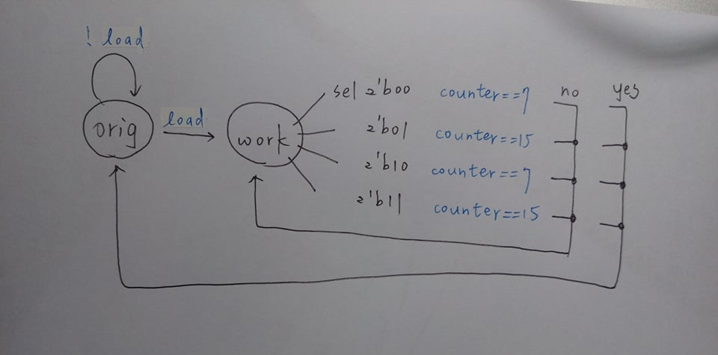
FSM

Slide 4
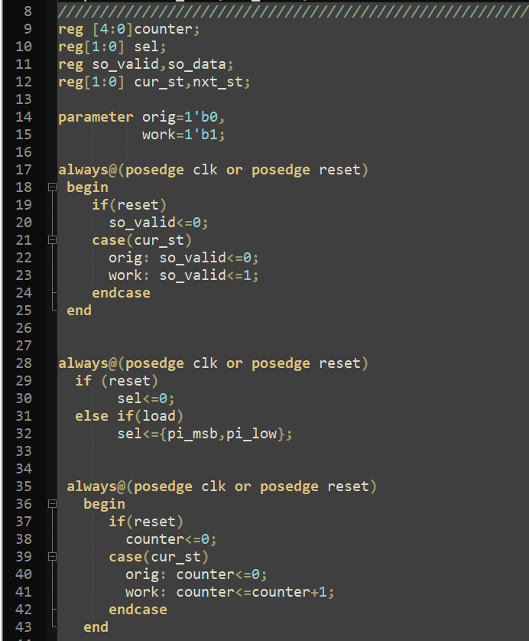
CODE

Slide 5
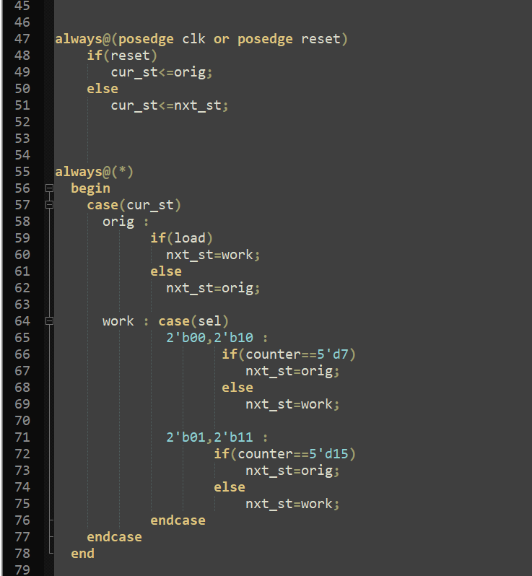
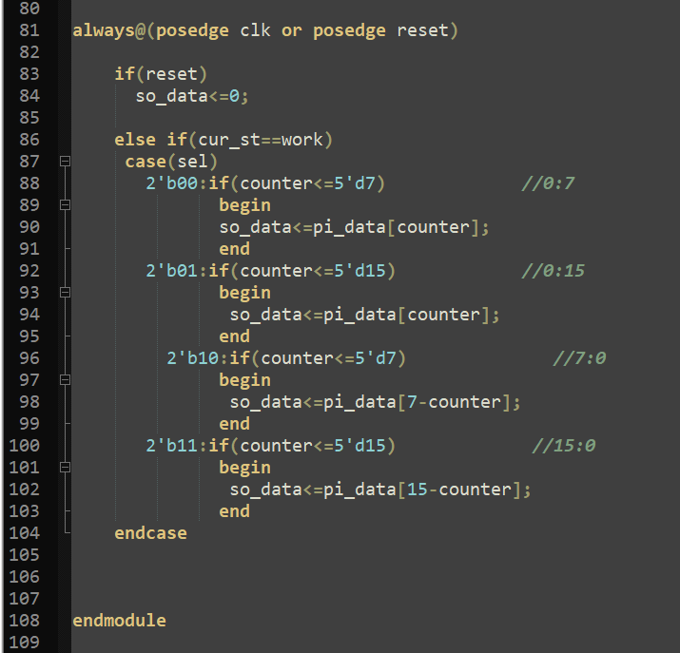

Slide 6
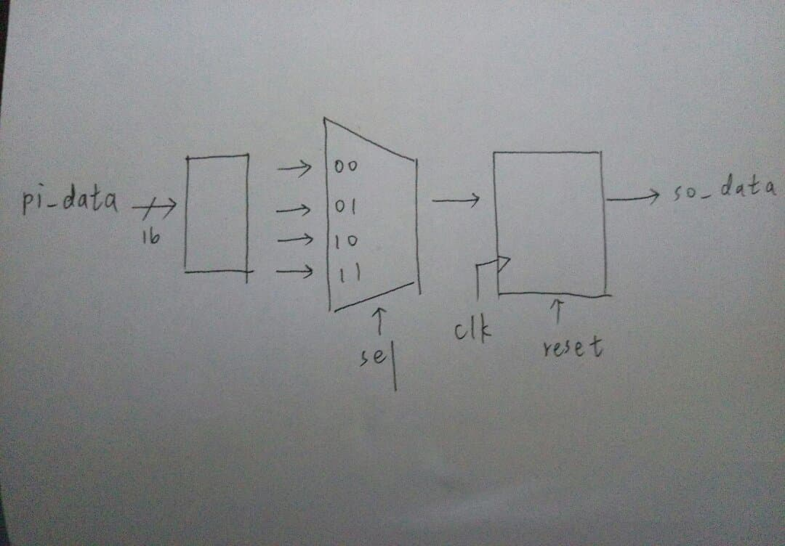
architecture

Slide 7
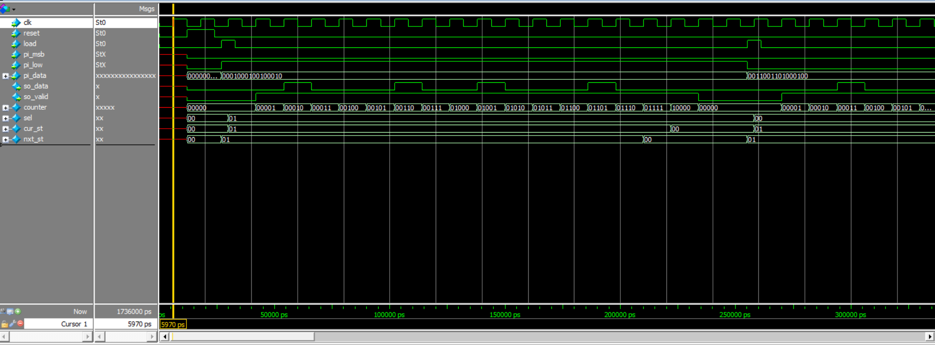
TIMING DIAGRAM

